Slide 1
Corona Virus Analysis
SQL Problem statements

Slide 2
Problem statement
The CORONA VIRUS pandemic has had a significant impact on public health and has created an urgent need for data-driven insights to understand the spread of the virus. As a data analyst, you have been tasked with analyzing a CORONA VIRUS dataset to derive meaningful insights and present your findings. The CORONA VIRUS pandemic has had a significant impact on public health and has created an urgent need for data-driven insights to understand the spread of the virus. As a data analyst, you have been tasked with analyzing a CORONA VIRUS dataset to derive meaningful insights and present your findings.

Slide 3
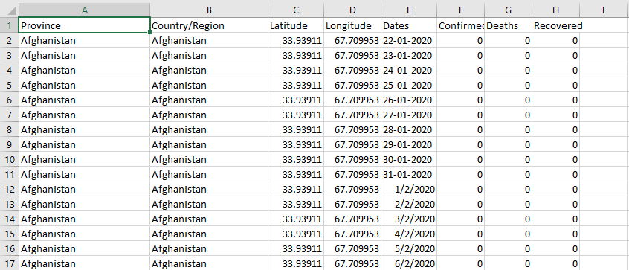
Reference dataset

Slide 4
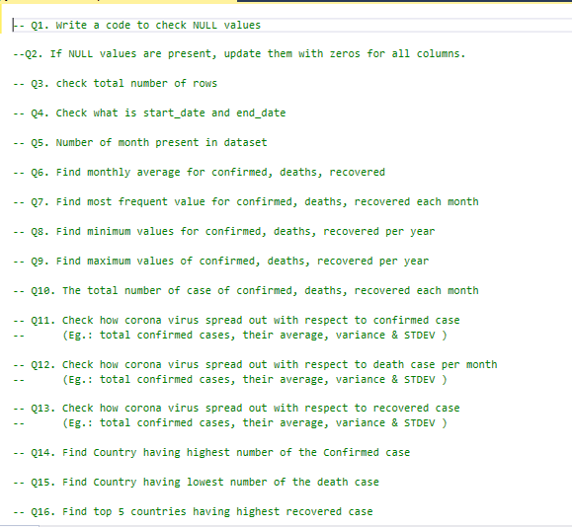

Slide 5




Q1. Write a code to check NULL values
Output:
Q2. check total number of rows
Output:

Slide 6



Q3. Check what is start_date and end_date
Output:
Q4. Number of month present in dataset
Output:

Slide 7
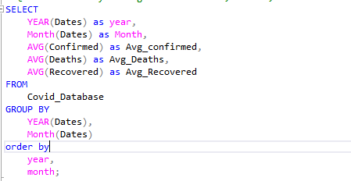
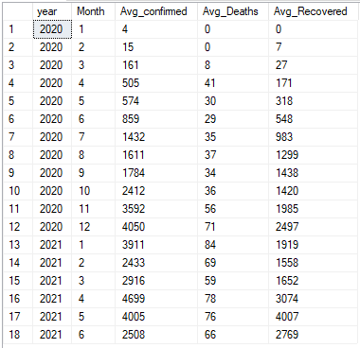
Q5. Find monthly average for confirmed, deaths, recovered
Output:

Slide 8
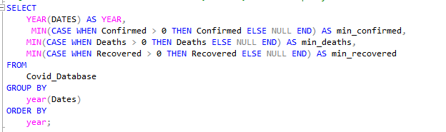
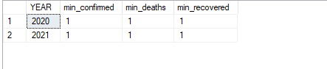
Q6. Find minimum values for confirmed, deaths, recovered per year
Output:

Slide 9
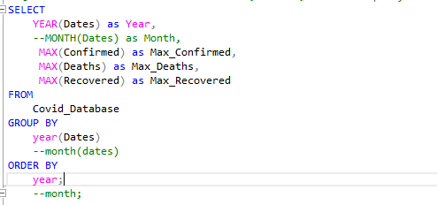

Q7. Find maximum values for confirmed, deaths, recovered per year
Output:

Slide 10
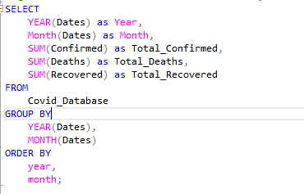
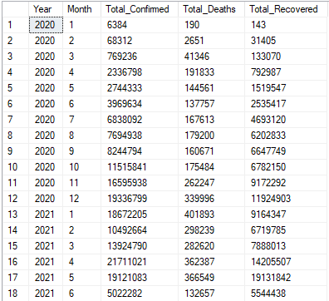
Q8. The total number of case of confirmed, deaths, recovered each month
Output:

Slide 11
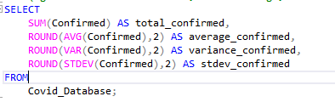
Q9. Check how corona virus spread out with respect to confirmed case (Eg.: total confirmed cases, their average, variance & STDEV )
Output:

Slide 12
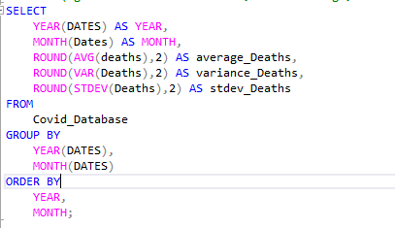
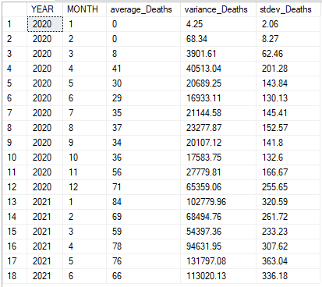
Q10. Check how corona virus spread out with respect to death case per month
-- (Eg.: total confirmed cases, their average, variance & STDEV )
Output:

Slide 13
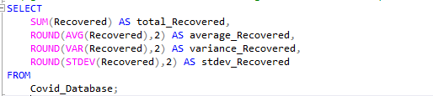
Q11. Check how corona virus spread out with respect to recovered case (Eg.: total confirmed cases, their average, variance & STDEV )
Output:

Slide 14
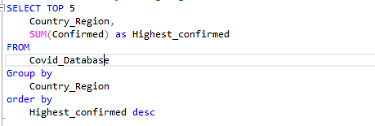
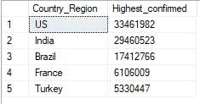
Q12. Find Country having highest number of the Confirmed case
Output:

Slide 15
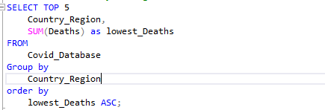
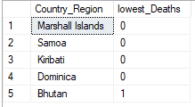
Q13. Find Country having lowest number of the Death cases
Output:

Slide 16
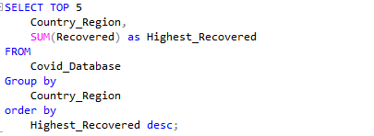
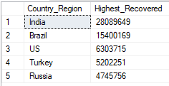
Q14. Find top 5 countries having highest recovered case
Output:

Slide 17
Thank You

